Slide 1

Six Areas of Business Planning
Key Person Coverage
Business Succession
Employee Financial Education
Retirement Plans
Group Employee Benefits
Executive Benefits
Securities & advisory services offered through SagePoint Financial, Inc.(SPF), member FINRA/SIPC. SPF is separately owned and other entities and/or marketing names, products or services referenced here are independent of SPF.

Slide 2
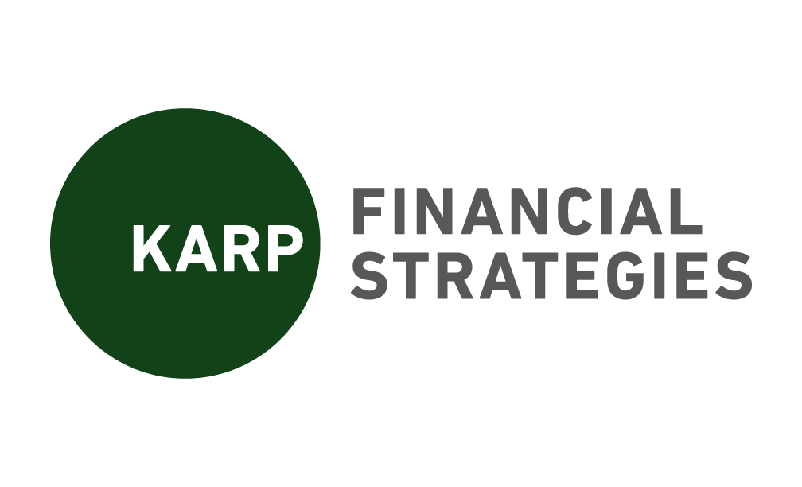
Six Areas of Business Planning
Business
Succession
Key Person
Coverage
Executive
Benefits
Group Employee
Benefits
Retirement
Plans
Employee Financial
Education
Buy/Sell Funding
Exit Planning
Succession Preparation
Talent Management
Purchase Funding
Estate Planning
Business value improvement
Golden Handcuffs
Life Insurance
Disability
Business Overhead
Directors & Officers Coverage
Total Reward Strategy
Bonus Plans
Equity Programs
Life Insurance
Supplemental Individual Disability
Financial Planning
Non-qualified Plans
Benefit Plan Funding
Health
Welfare
Voluntary
Non-cash recognition
Benefit Optimization
Defined Contribution Plans
* 401(k)
* 403(b)
* SEP
* SIMPLE
Defined benefits
  * Pensions
  * 412(e)
Profit-sharing Plans
Workshops
Holistic Planning
Benefit Communication
One-on-One Consultations
Securities & advisory services offered through SagePoint Financial, Inc.(SPF), member FINRA/SIPC. SPF is separately owned and other entities and/or marketing names, products or services referenced here are independent of SPF.

